Slide 1


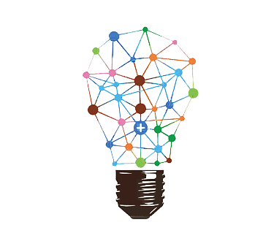
Free
Masterclass
Machine Reasoning using LLM
By. Prasanna Venkatesh .J

Slide 2
Agenda
Introduction to Reasoning
Machine Reasoning approaches
Machine Reasoning on LLM Approaches
- Lang chain Agent Introduction - LIVE DEMO
- Chain of Thought - LIVE DEMO
- ReAct Framework - LIVE DEMO
Machine Reasoning Enterprise usecases

Slide 3
Introduction to Reasoning
Example:
Premise 1: All humans are mortal.
Premise 2: Raghu is a human.
Conclusion: Therefore, Raghu is mortal.
Example: Deductive Reasoning - Drawing a specific conclusion from general principles or premises and logical relationship between statement.

Slide 4
Various Types of Reasoning
Premise : Every cat I've seen so far has fur.
Conclusion: Therefore, all cats must have fur.
Premise : The ground is wet outside.
Premise : It's cloudy and the weather forecast predicts rain.
Premise : Eating unhealthy food regularly is associated with weight gain.
Case-Based Reasoning
Premise : Last time I had a headache, drinking water helped relieve it.
Conclusion: There's a higher chance of rain today.
Conclusion: If I continue to eat unhealthy food, I might gain weight.
Conclusion: If I have a headache again, I should try drinking water.
Causal Reasoning
Probabilistic Reasoning
Abductive Reasoning
Inductive Reasoning
Conclusion: It must have rained. (based on your existing knowledge).

Slide 5
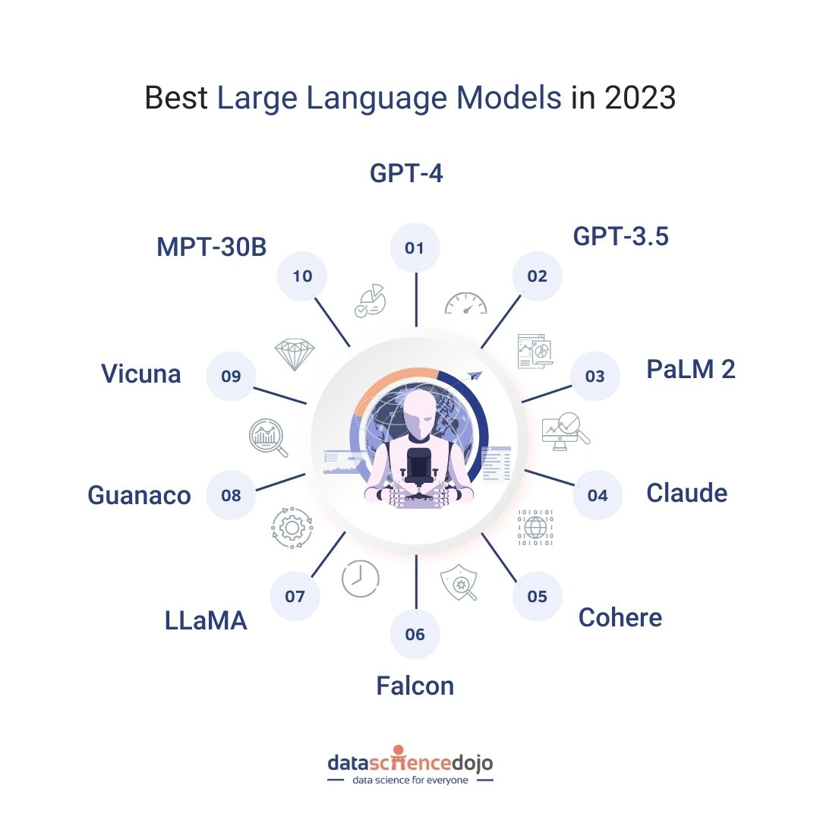
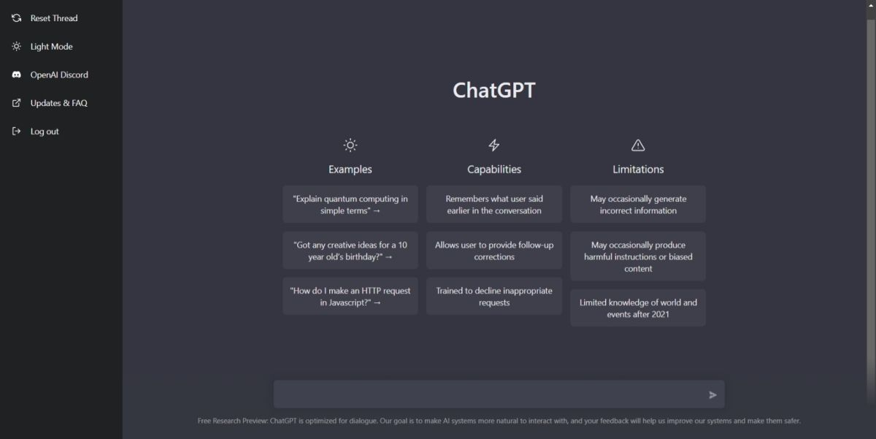
Large Language Models

Slide 6
Machine Reasoning using LLM Approaches
ReAct: Synergizing Reasoning and Acting in Language Models
https://arxiv.org/abs/2210.03629
Comparison of various approaches to Reason:
Apply the Reasoning directly on the LLM (COT).
Using the Actions.
Combining the Reasoning and Action (ReAct) Model

Slide 7
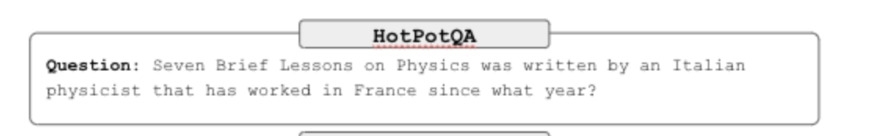
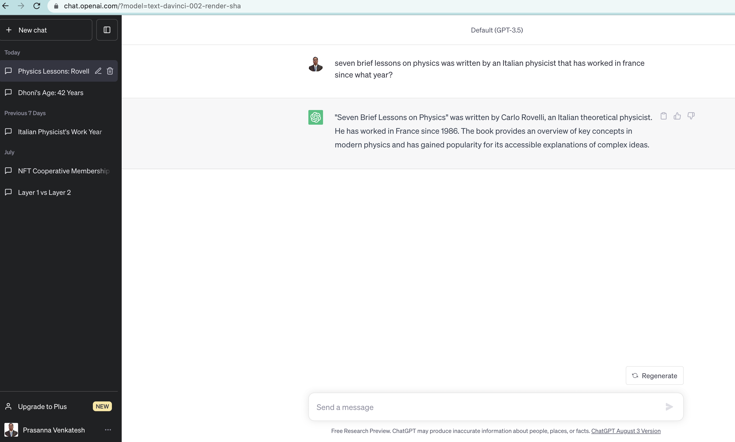
Machine Reasoning using LLM Approaches

Slide 8
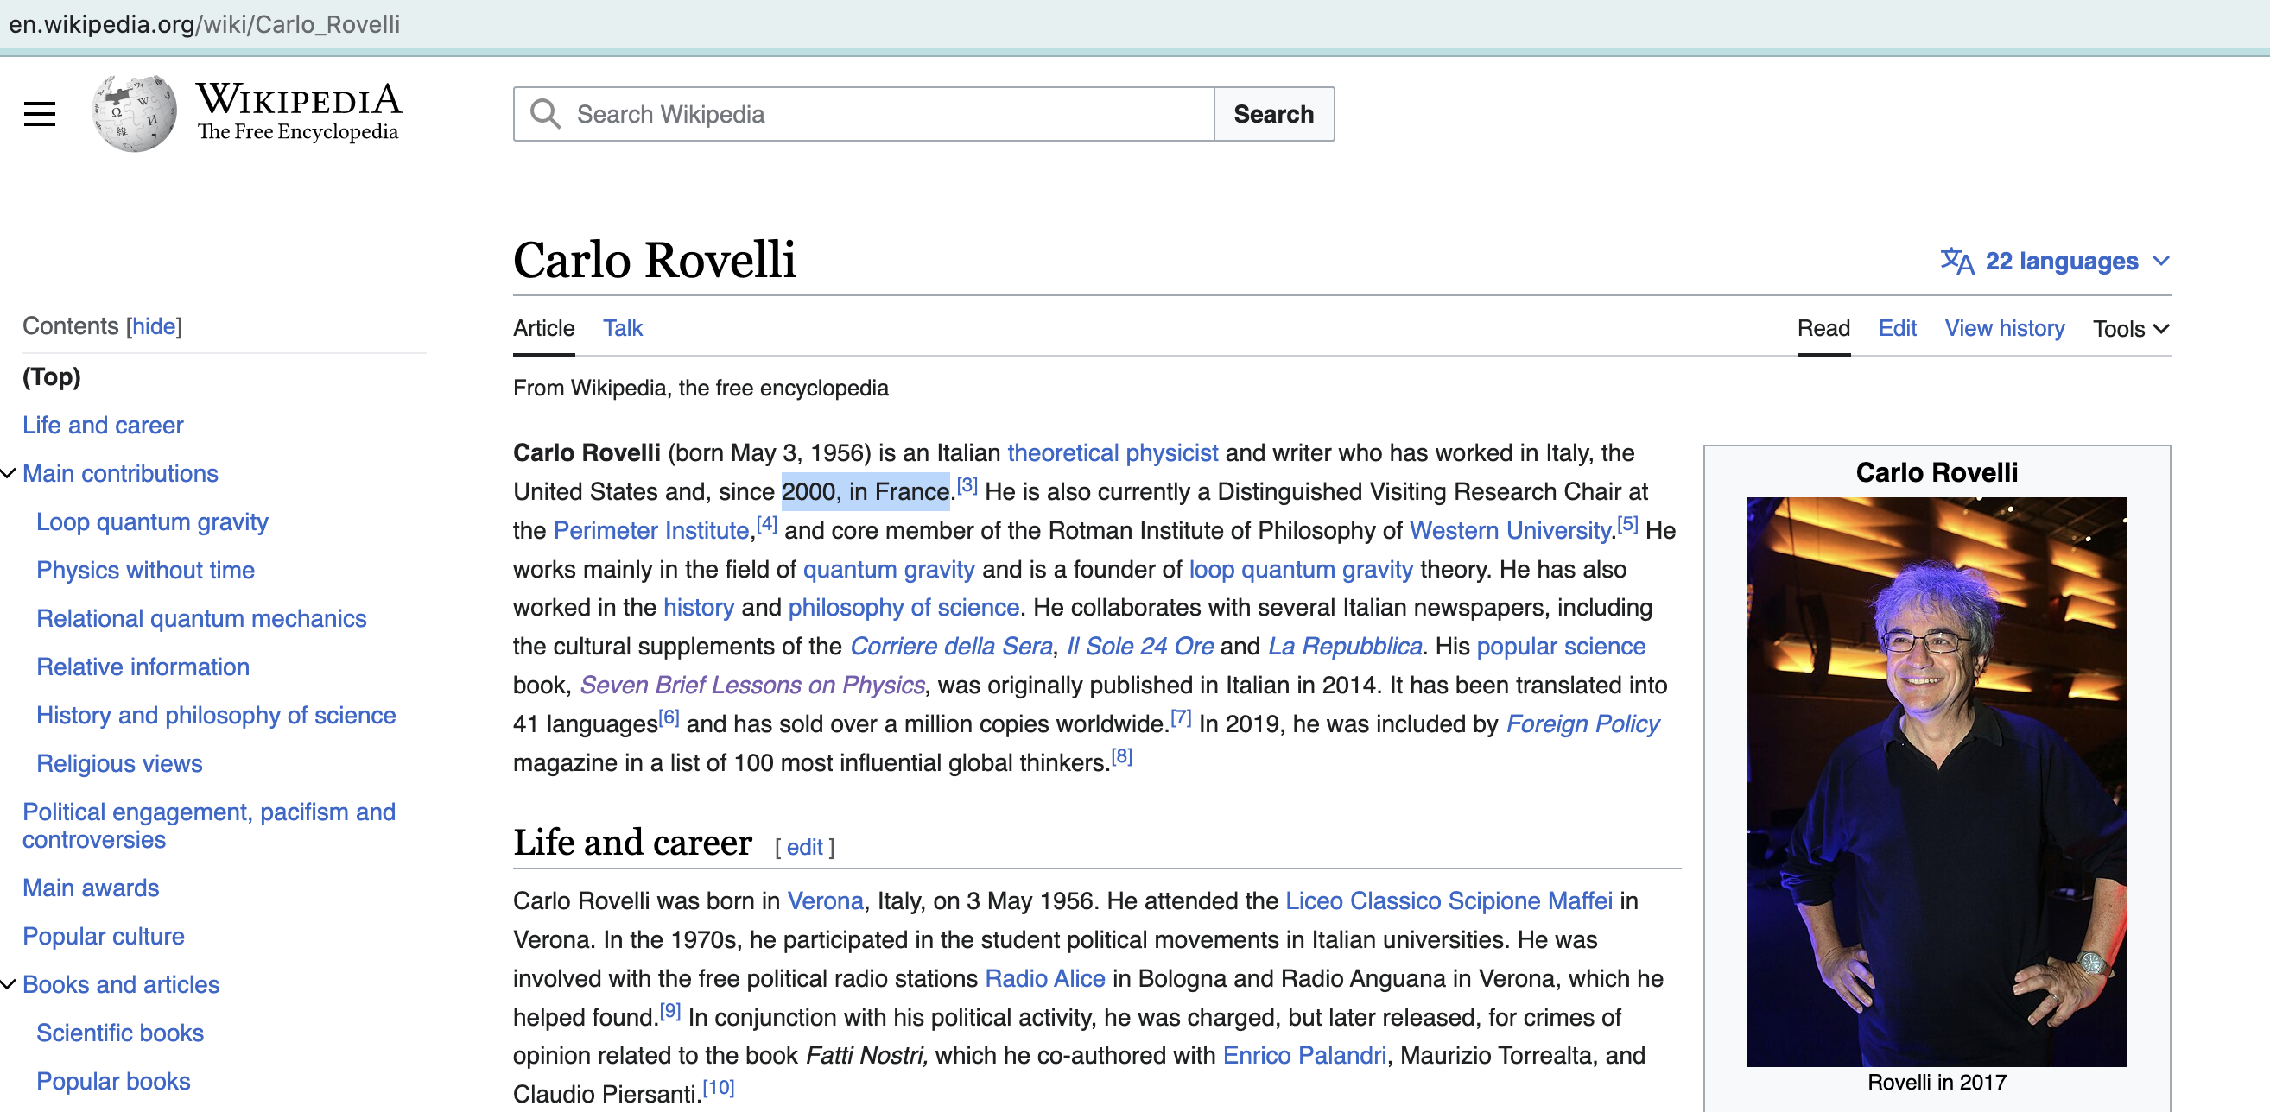

Slide 9
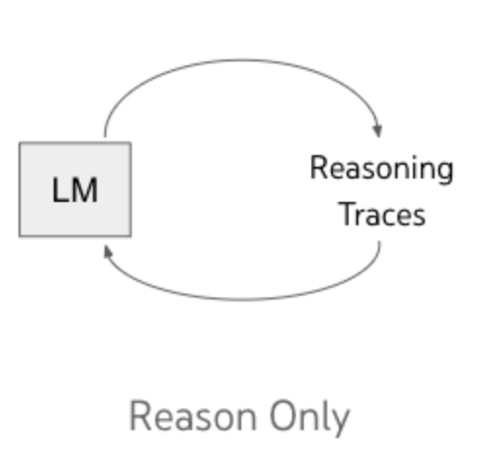
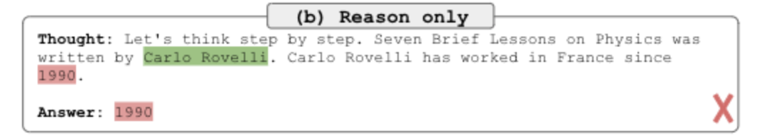
Machine Reasoning using LLM Approaches
ReAct: Synergizing Reasoning and Acting in Language Models
https://arxiv.org/abs/2210.03629

Slide 10
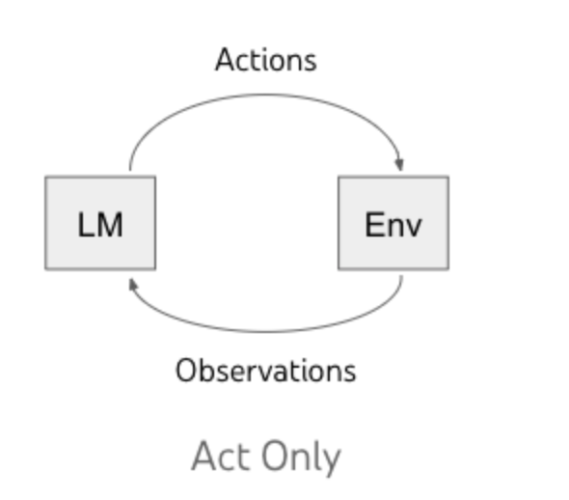
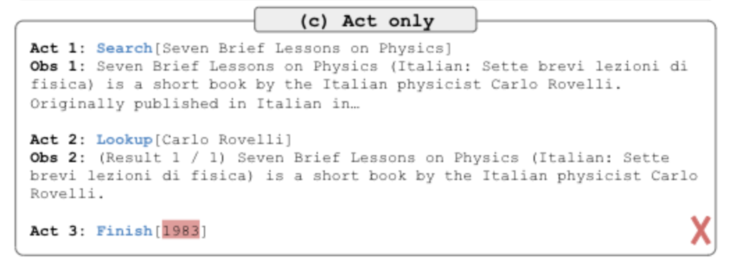
Machine Reasoning using LLM Approaches

Slide 11
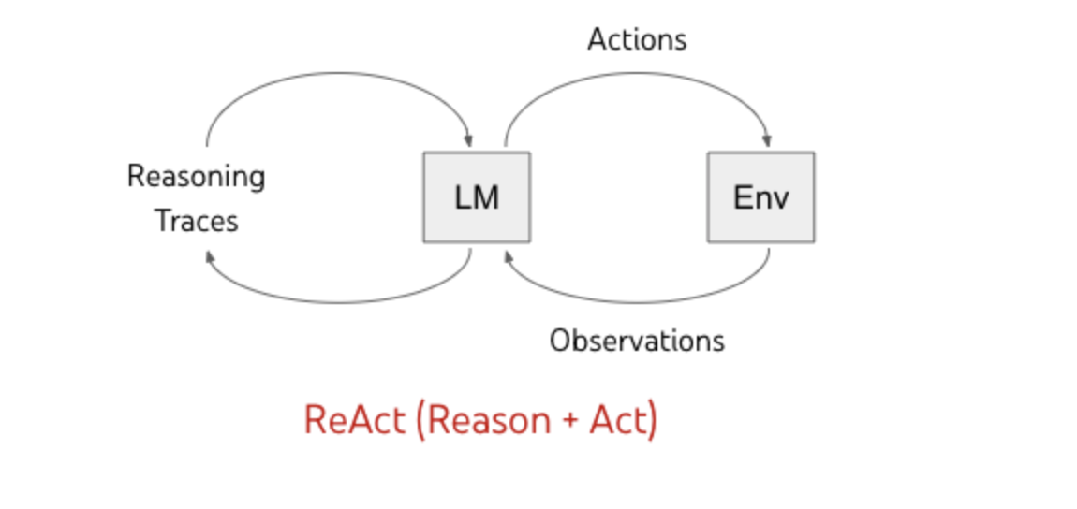
Machine Reasoning using LLM Approaches
Steps followed on ReAct:
Thought
Action
Observation
ThoughtAction
Observation
(Repeat …N time)
Finish

Slide 12
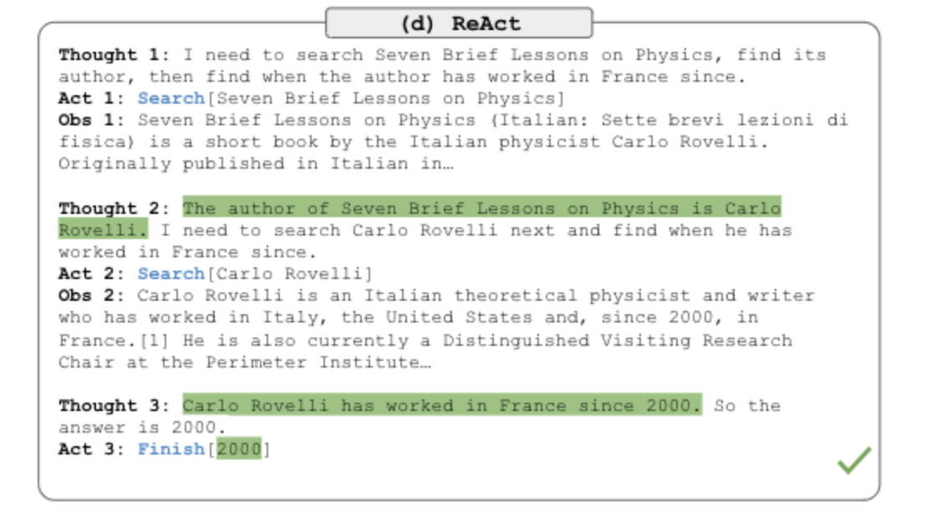
Machine Reasoning using LLM Approaches
ReAct
Re- Reasoning
Act - Action

Slide 13
Machine Reasoning using LLM Approaches

Slide 14
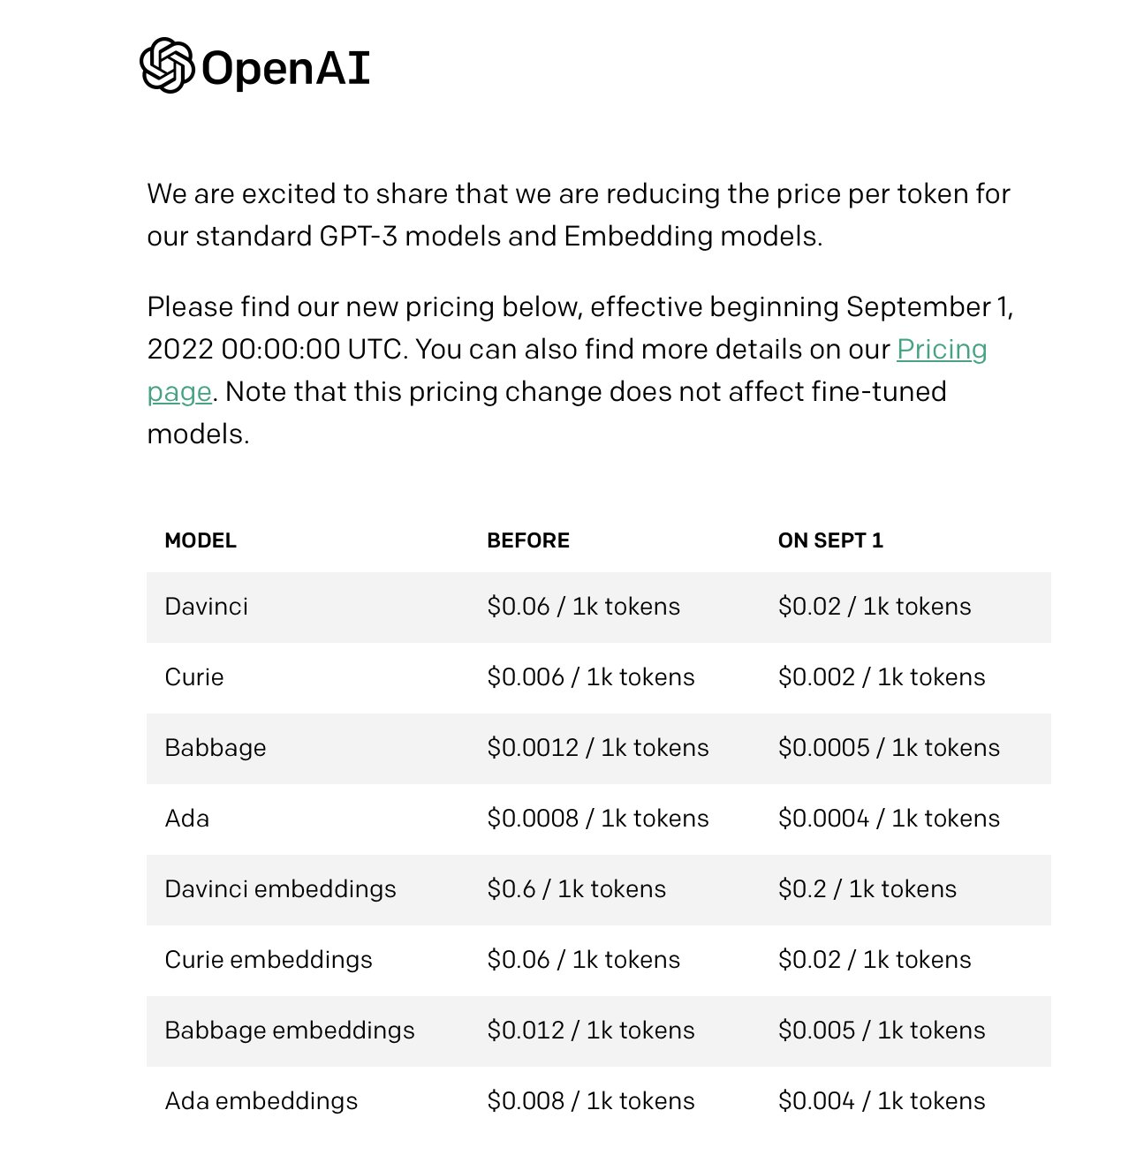
Live Demo Setup
Basics Refresher - NLP (Natural Language Processing) - OpenAI Model

Slide 15
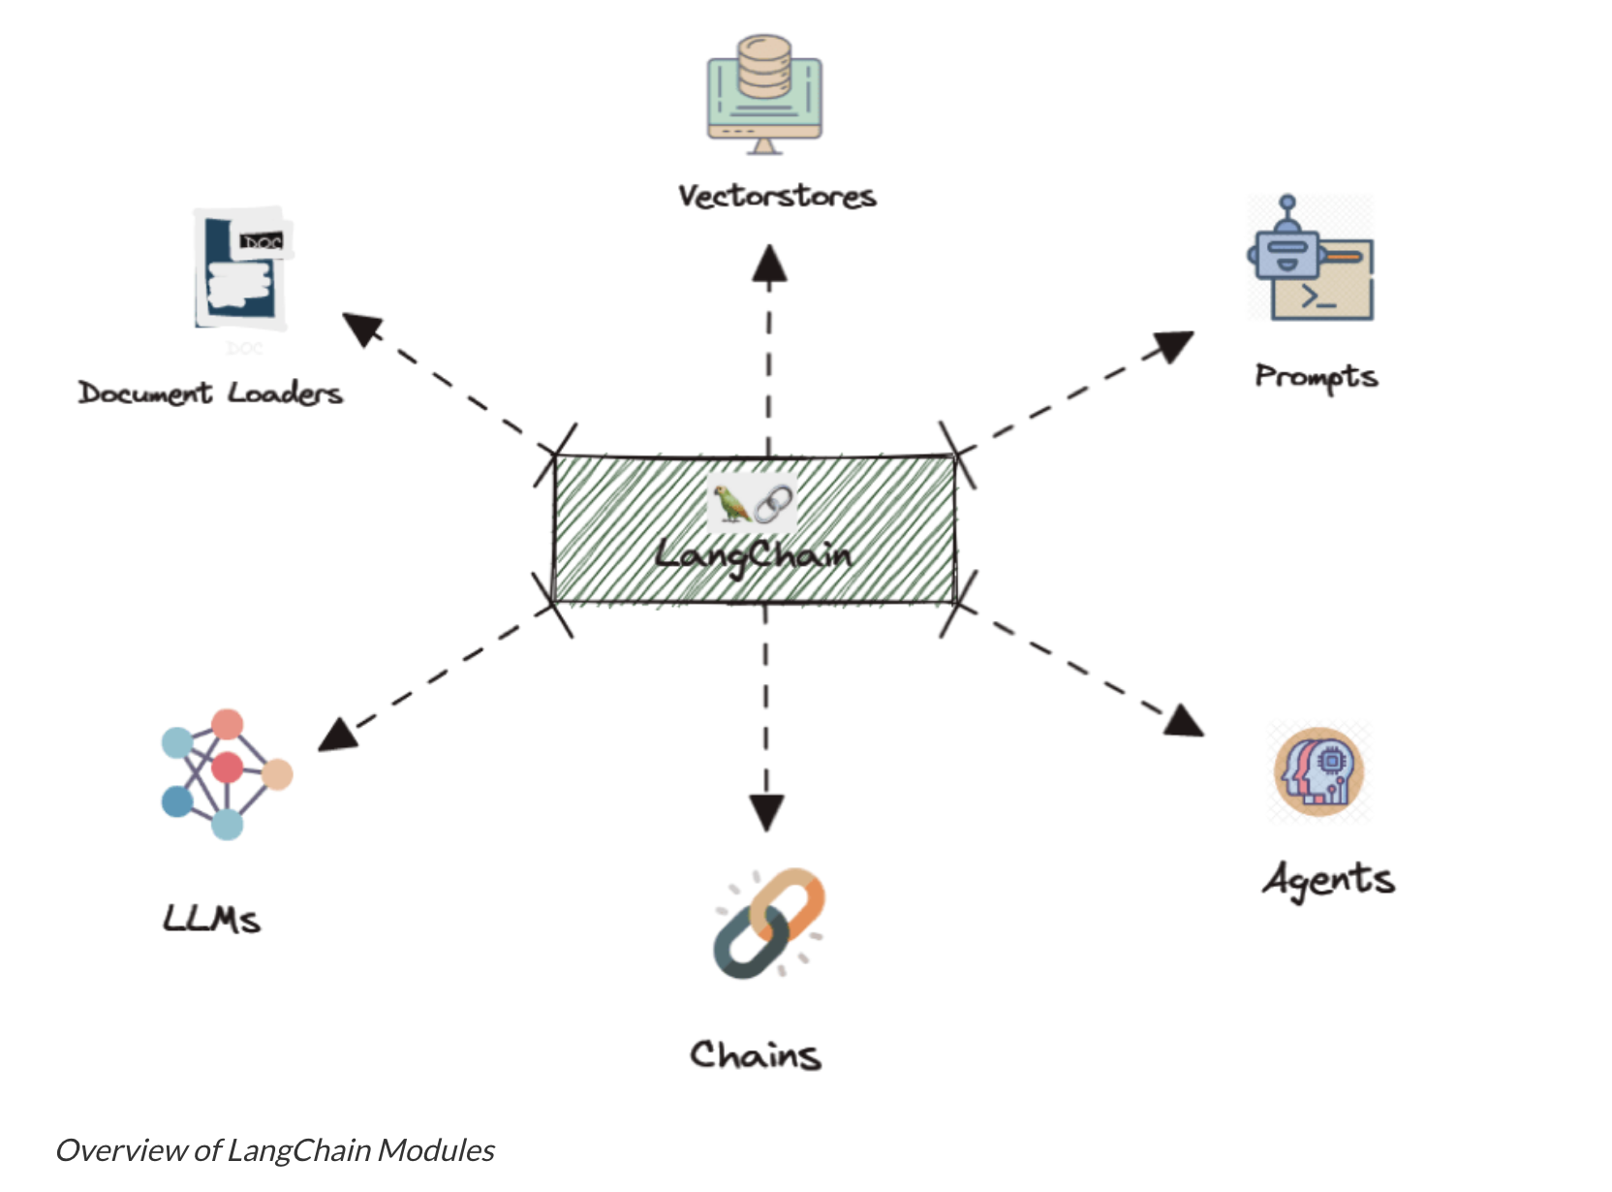
LangChain
Live Demo Setup
Basics Refresher - LLM framework

Slide 16
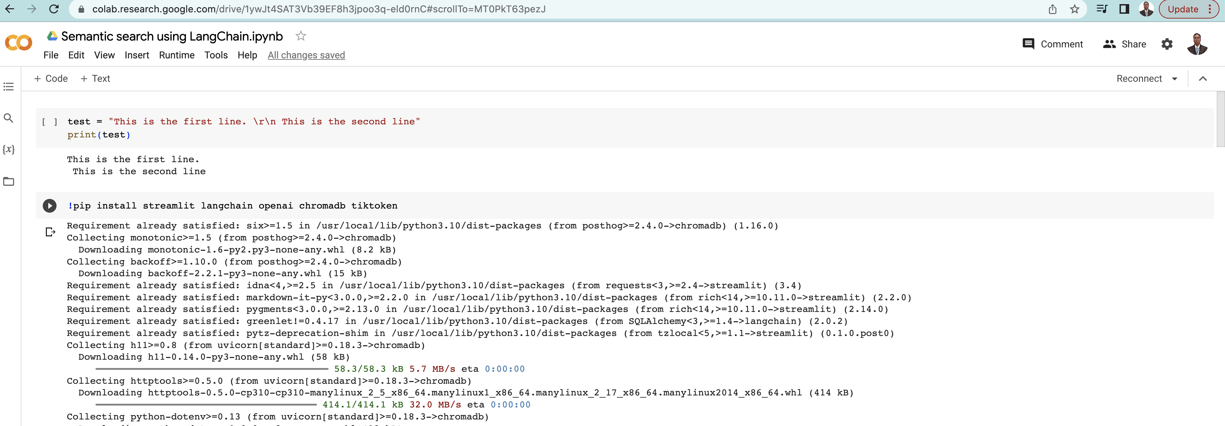
Google CoLab
Live Demo Setup
Basics Refresher - LLM framework Development Environment

Slide 17
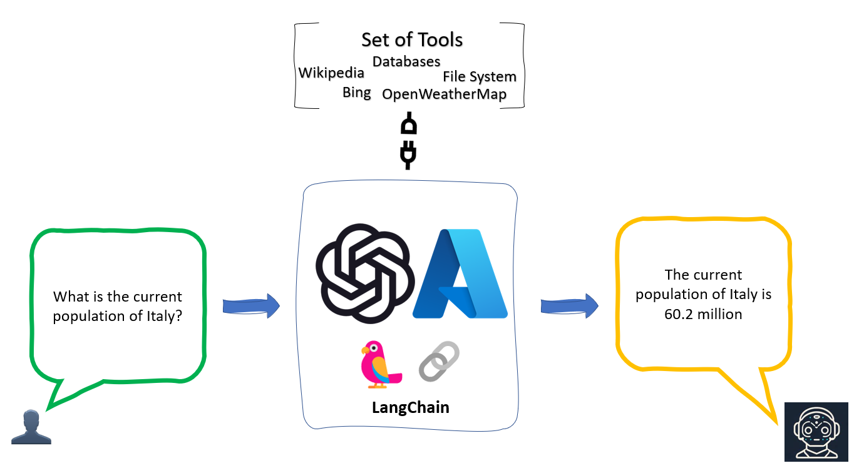
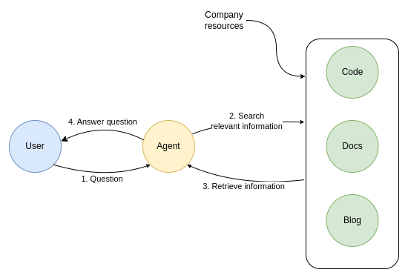
LangChain – Agent - Live Code Demo

Slide 18
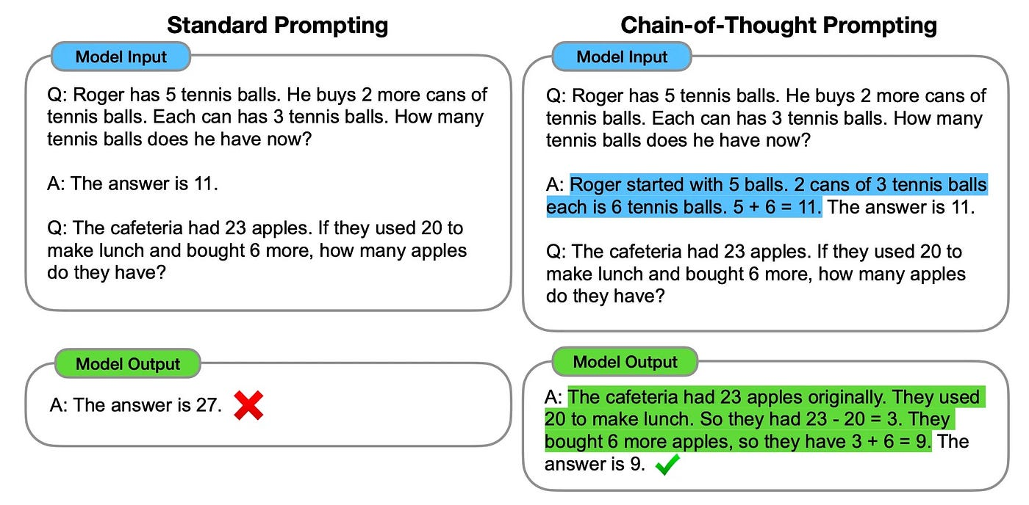
Chain of Thought using Open AI LLM API - LIVE DEMO

Slide 19
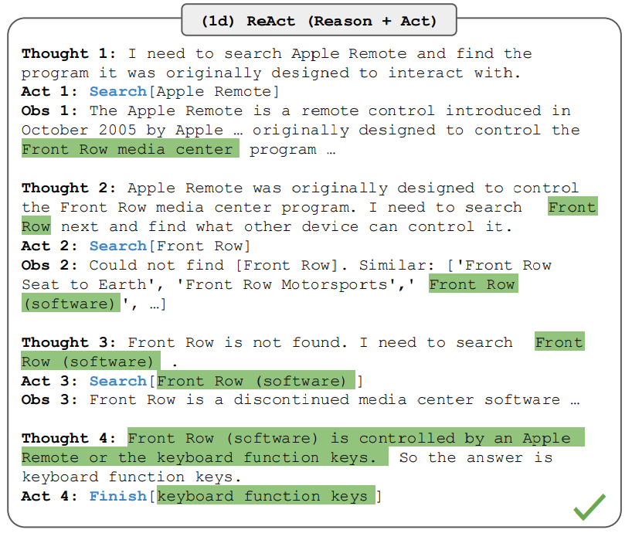
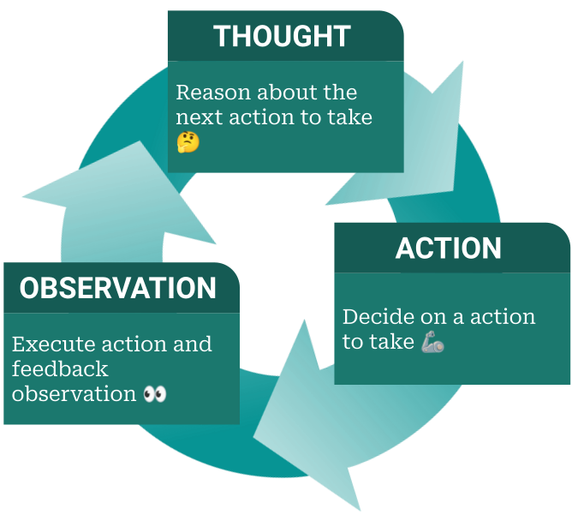
ReAct using Open AI LLM API - LIVE DEMO

Slide 20
Machine Reasoning – Advanced Implementations
Medical Diagnosis (Expert System)
Given a patient's symptoms and medical history, an expert system uses symbolic reasoning and knowledge representation to diagnose a complex medical condition, considering various factors, possible causes, and treatment options.
Natural Language Understanding
An AI-powered chatbot interprets and responds to user queries using natural language processing and semantic reasoning
Autonomous Vehicles Decision-Making
An autonomous vehicle employs probabilistic reasoning, sensor data fusion, and decision trees to navigate complex traffic scenarios, make real-time decisions, and ensure passenger safety.
Game Playing Strategies (Chess or Go)
AI algorithms employ a combination of search-based reasoning, positional evaluation, and pattern recognition to make optimal moves in complex games like chess or Go.
Predictive Analytics
Using machine learning and statistical reasoning, AI analyzes large datasets of patient information to predict disease outbreaks, identify potential epidemics, and guide public health interventions.
Fraud Detection in Financial Transactions
AI systems analyze patterns in large-scale financial data to detect anomalies and potential fraudulent activities, using advanced statistical modeling and anomaly detection algorithms.
Scientific Discovery (Drug Design)
AI-driven molecular simulations and quantum chemistry models assist researchers in complex reasoning tasks, predicting molecular interactions and aiding in the design of new drugs or materials.

Slide 21

Q&A
To Connect:
Email:
prasannavj@gmail.com
LinkedIn:
https://www.linkedin.com/in/prasanna-venkatesh-jayaprakash/
GitHub:
https://github.com/prasannavj/

Slide 22
